Slide 1
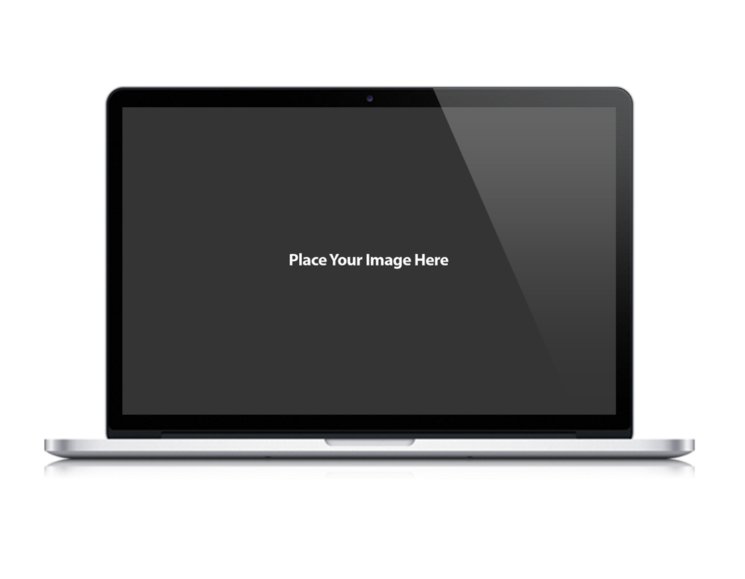
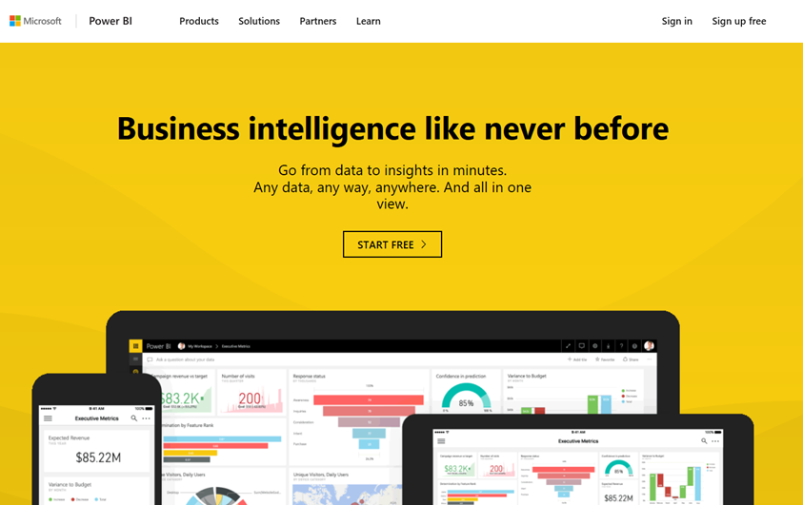
Microsoft Power BI
PBICAT
App-Owns-Data Starter Kit
Ted Pattison Power BI Customer Advisory Team (PBICAT)

Slide 2
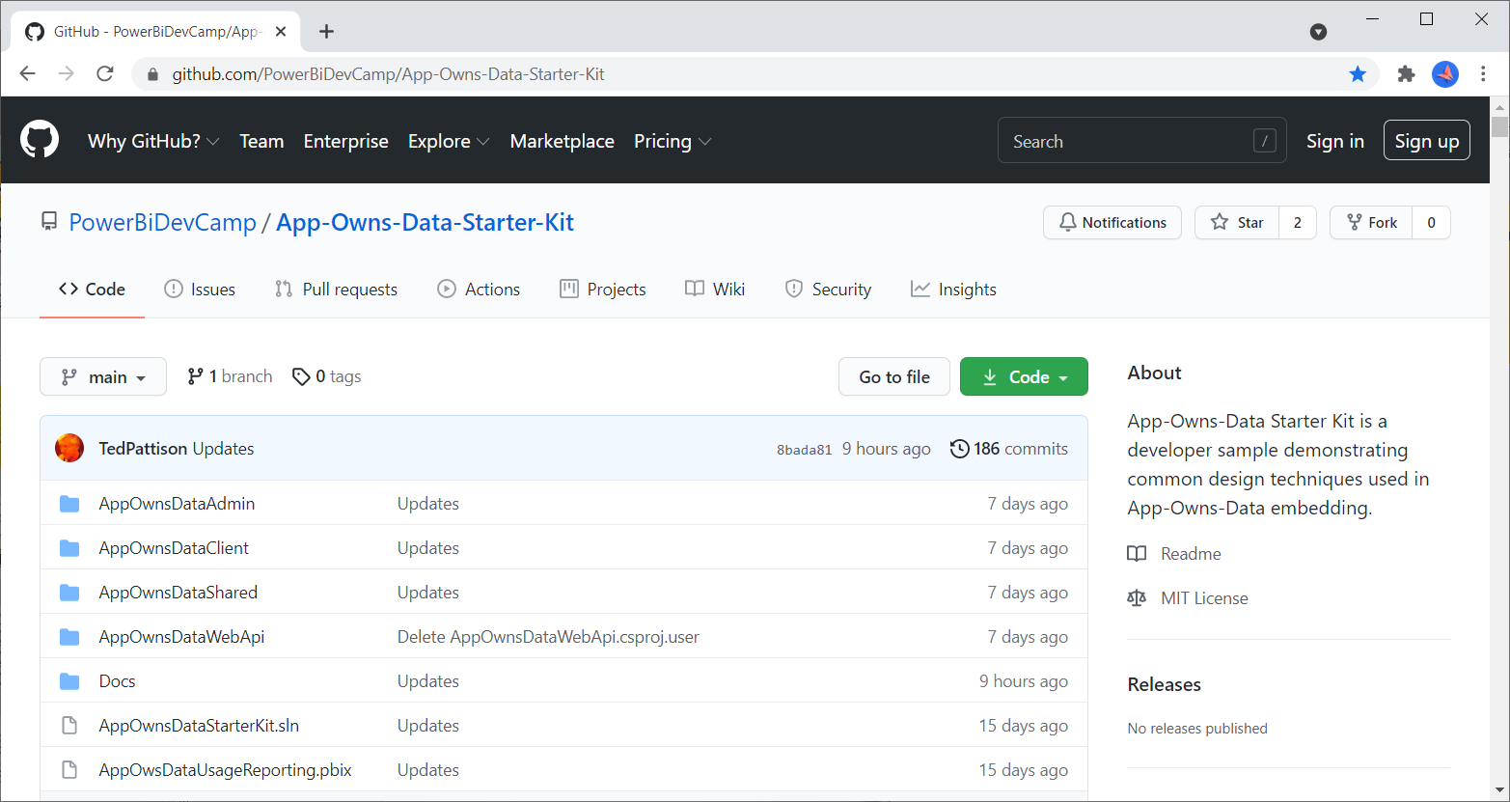
App-Owns-Data Starter Kit on GitHub
https://github.com/PowerBiDevCamp/App-Owns-Data-Starter-Kit

Slide 3
Agenda
Solution Architecture
Set up your development environment
Open the App-Owns-Data Starter Kit in Visual Studio
Test the AppOwnsDataAdmin application
Test the AppOwnsDataClient application
Use activity logs to monitor user activity and report performance

Slide 4

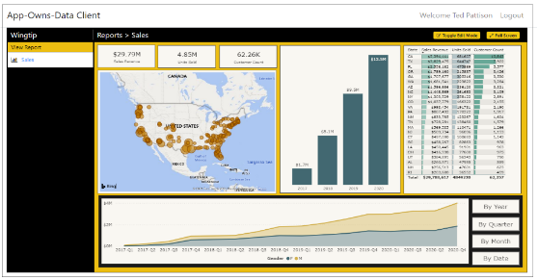
Customer Tenants in App-Owns-Data Embedding
Tenant represents a customer with one or more users
You must create a separate tenant footprint in Power BI for each customer
Power BI environment
Customer 01
17 users
Customer 01 Tenant
Sales
Power BI Workspace
Power BI Dataset
Datasource credentials
Power BI Report

Slide 5
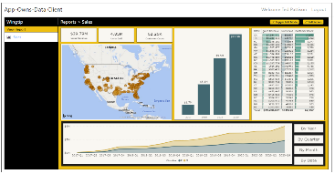
Designing a Multi-tenant Environment
Power BI Multi-tenant Environment
Customer 01
17 users
Customer 01 Tenant
Sales
Power BI Workspace
Power BI Dataset
Datasource credentials
Power BI Report
Customer 02
243 users
Customer 02 Tenant
Sales
Power BI Workspace
Power BI Dataset
Datasource credentials
Power BI Report
Customer N
74 users
Customer N Tenant
Sales
Power BI Workspace
Power BI Dataset
Datasource credentials
Power BI Report

Slide 6
App-Owns-Data Embedding & Authorization
Power BI doesn’t know anything about your users
Power BI cannot provide assistance when it comes to authorization
Not an issue in scenario where all users see all content with the same access
Your application must add explicit support for any authorization scheme
Key observations about App-Owns-Data embedding
you have flexibility to design the authorization scheme any way you'd like
you have responsibility to build authorization scheme from the ground up
you should use custom database to track the authorization data you need

Slide 7
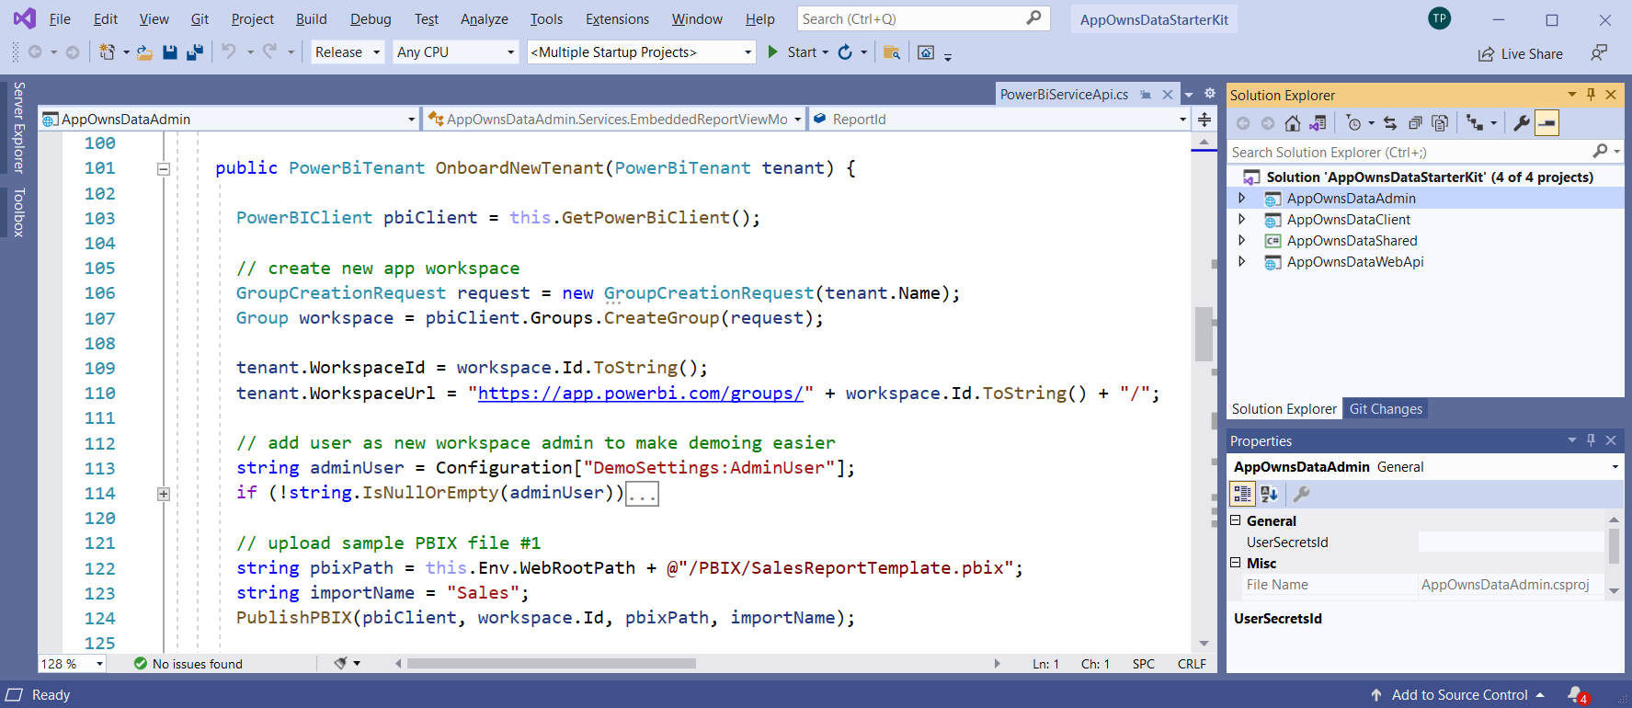
The App-Owns-Data Starter Kit Solution
Created to provide starting point for ISVs and large organizations
Built using .NET 5 and ASP.NET CORE
Can be open and tested with Visual Studio 2019 or Visual Studio Code

Slide 8
App-Owns-Data Starter Kit - Value Proposition
Provides guidance for the following tasks and procedures
Onboarding new customer tenants
Managing user permissions
Implementing client as Single Page Application (SPA)
Creating a custom telemetry layer to log user activity
Monitoring user actions such as viewing, editing, and creating reports
Monitoring report performance for loading and report rendering

Slide 9
Solution Architecture
AppOwnsDataDB: custom database to track tenants, user permissions and custom activity log
AppOwnsDataAdmin: administrative app to create tenants and manage user permissions.
AppOwnsDataClient: customer-facing SPA used to view and author reports.
AppOwnsDataWebApi: custom Web API used by the AppOwnsDataClient application.
AppOwnsDataAdmin
AppOwnsDataDB
Power BI REST API
AppOwnsDataClient
AppOwnsDataWebAPI

Slide 10
AppOwnsDataAdmin
Uses Power BI REST API to provision workspaces for customer tenants
Calls to Power BI REST API as a service principal – not a user
Adds a record to AppOwnsDataDB for each customer tenant
AppOwnsDataAdmin
Power BI REST API
Azure AD Service App
AppOwnsDataDB

Slide 11
Common Tenant Provisioning Requirements
Create a new Power BI workspace
Assign workspace to a dedicated capacity
Import templates PBIX files to create datasets and reports
Update connection string to redirect dataset to customer’s database
Patch datasource credentials
Start dataset refresh operations

Slide 12
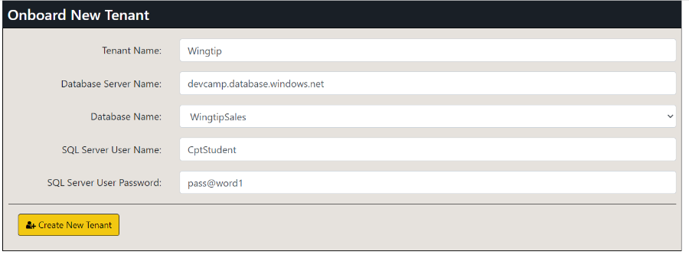
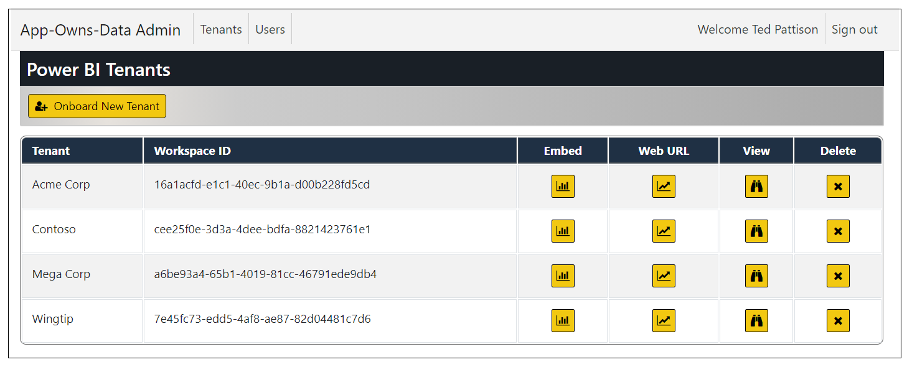
Creating Customer Tenants

Slide 13
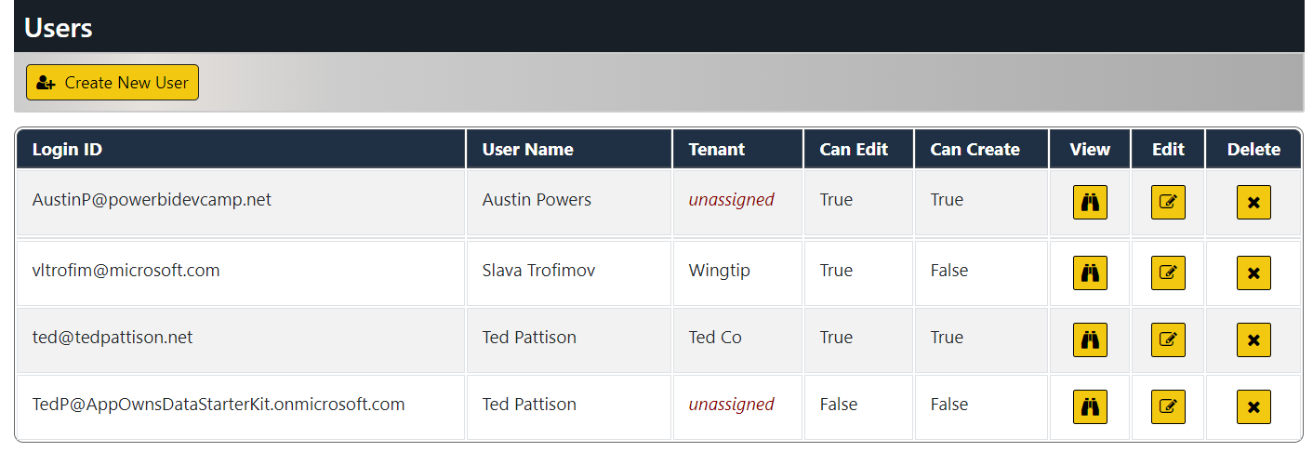
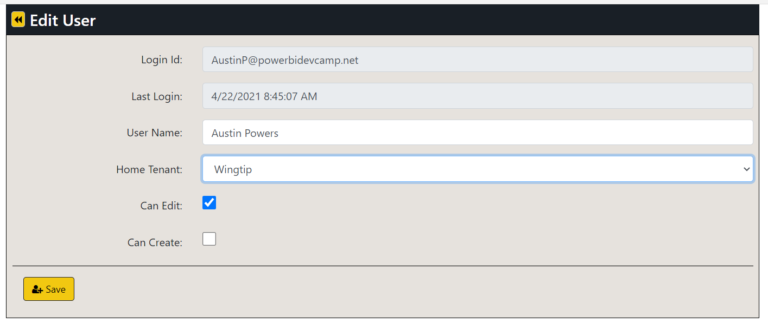
Managing User Permissions

Slide 14
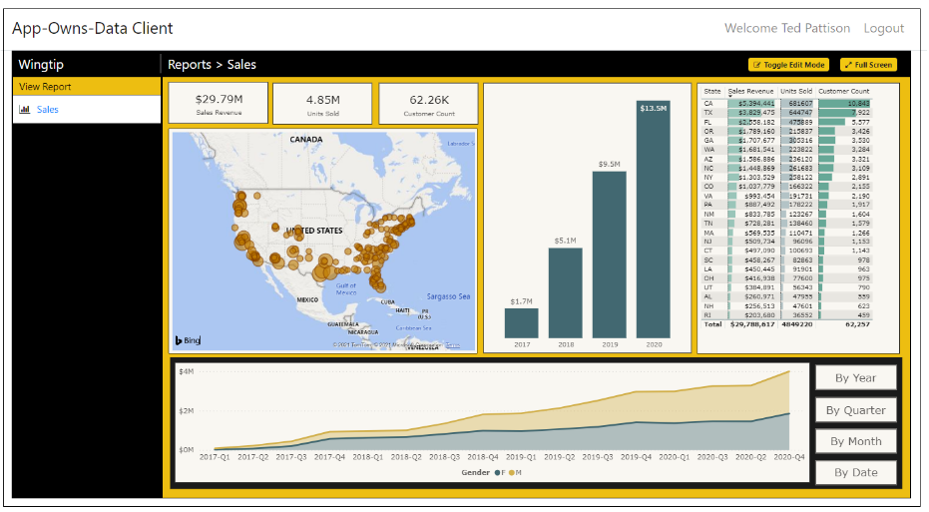
AppOwnsDataClient
Built as simple Single Page Application (SPA)
Client authenticates user and acquires access tokens to call AppOwnsDataWebApi
Project configured with node.js and webpack to support Typescript compilation
Project includes node.js packages for jQuery and Power BI JavaScript API
Project easily extended to support development with React or Angular
AppOwnsDataClient
Azure AD
Client App
AppOwnsDataWebAPI

Slide 15
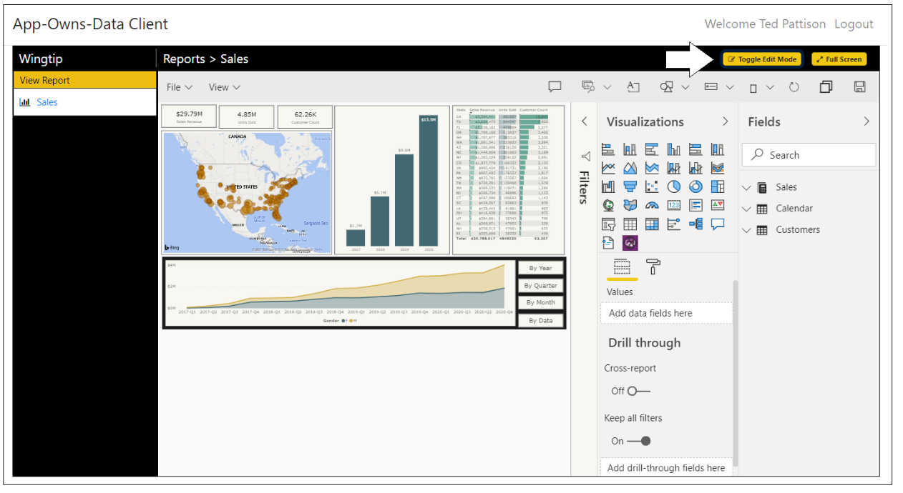
Report Authoring
AppOwnsDataClient demonstrates report authoring features
Users with edit permissions can move report into edit view and customize layout
Users with create permissions can create new reports

Slide 16
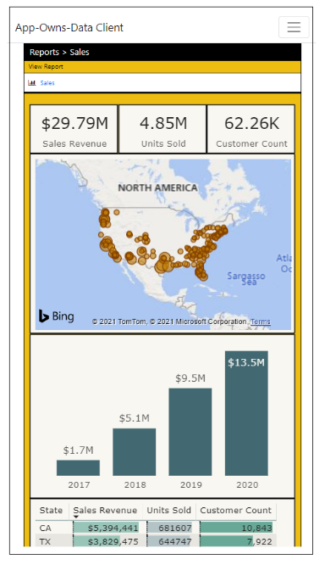
Responsive Design
Supporting mobile devices is a common application requirement
AppOwnsDataClient demonstrates responsive design strategy
Power BI report template designed with master view and mobile view
Client app has logic to switch between master view and mobile view

Slide 17
Identity Providers and App-Owns-Data Development
App-Owns-Data development allows you to pick any identity provider
App-Owns-Data Starter Kit uses Azure AD as client app identity provider
Solution architecture designed to facilitate using a different identity provider
AppOwnsDataClient
Azure AD
AppOwnsDataWebAPI
AppOwnsDataClient
OneLogin
AppOwnsDataWebAPI
AppOwnsDataClient
PING
AppOwnsDataWebAPI
AppOwnsDataClient
AppOwnsDataWebAPI
AppOwnsDataClient
Auth0
AppOwnsDataWebAPI
Okta

Slide 18
AppOwnsDataWebApi
Provides service-oriented architecture endpoints for AppOwnsDataClient
Provides endpoint to process user login
Provides endpoint to retrieve embedding data and embed tokens
Provides endpoint to log activity events to be recorded in AppOwnsDataDB
AppOwnsDataClient
AppOwnsDataWebAPI
Power BI REST API
Azure AD Client App
Azure AD Service App
AppOwnsDataDB

Slide 19
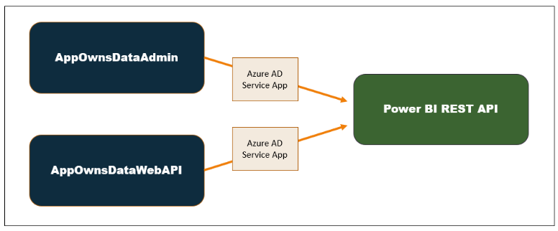
Using a single service principal
AppOwnsDataAdmin calls Power BI REST API to create and configure workspaces
AppOwnsDataWebAPI calls Power BI REST API to generate embed tokens
Both applications run under identity of single service principal
Service principal has admin permissions on any workspaces that it creates

Slide 20
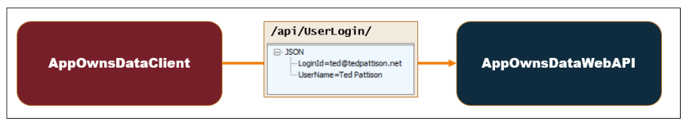
User Login
AppOwnsDataClient calls UserLogin endpoint after authenticating user
AppOwnsDataWebAPI updates last login time for existing users
AppOwnsDataWebAPI creates new record for first-time users
New users have no access to content until they are assigned to a customer tenant

Slide 21
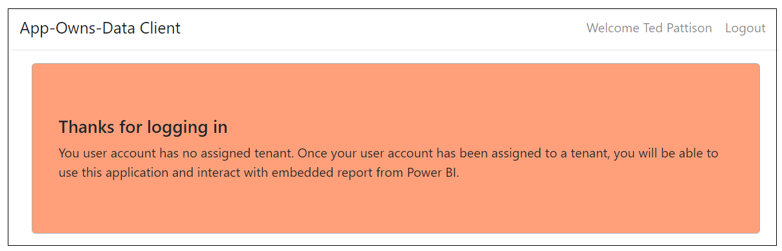
Unassigned users have no access to content
New users created without being assigned to tenant
Users cannot see content until they are assigned to tenant

Slide 22
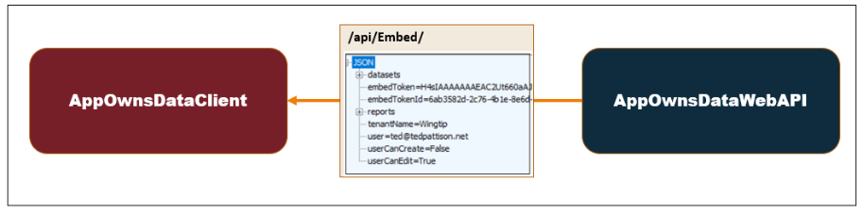
Embedding Data View Model
AppOwnsDataWebAPI returns view model to AppOwnsDataClient
View model contains embedding data for reports and datasets
View model contains embed token used to embed reports
Embed tokens contains set of permissions generated for current user

Slide 23
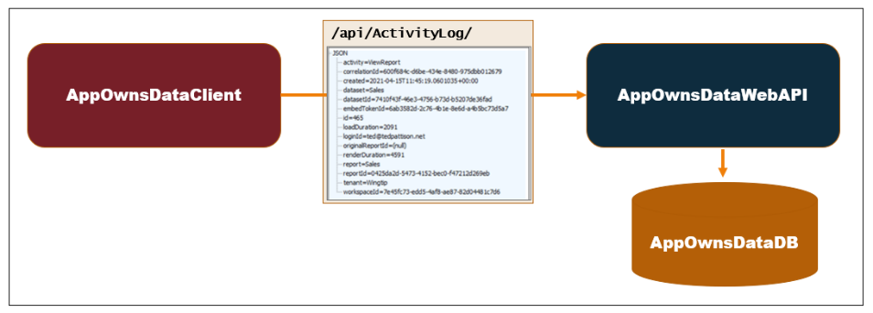
Adding a custom telemetry layer
App-Owns-Data Starter Kit demonstrates adding custom telemetry
AppOwnsDataWebAPI exposes ActivityLog endpoint
AppOwnsDataClient logs custom events by posting to ActivityLog endpoint
AppOwnsDataWebAPI creates record in AppOwnsDataDB to track activity

Slide 24
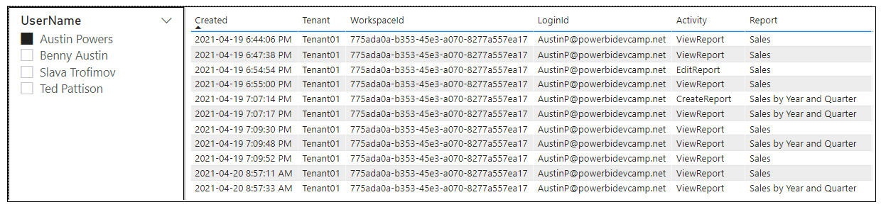
Monitoring User Activity
Activity log data stored in ActivityLog table of AppOwnsDataDB
Makes it possible to monitor user activity with Power BI Desktop project
App-Owns-Data Starter Kit provides

Slide 25
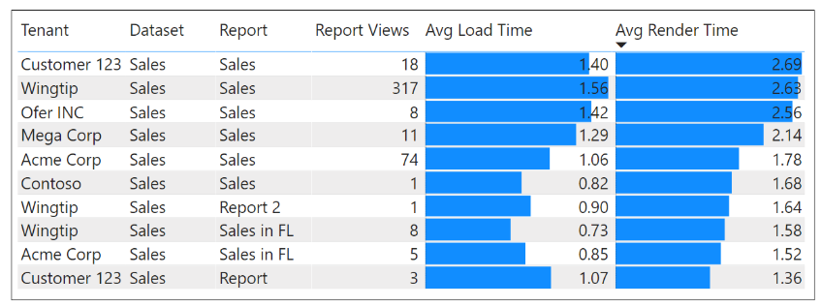
Monitoring Report Performance

Slide 26
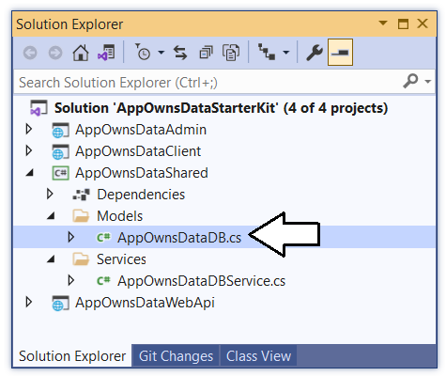
AppOwnsDataShared class library

Slide 27
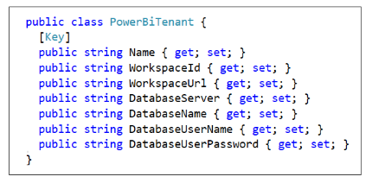
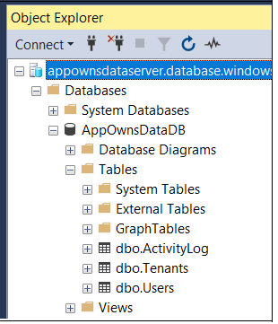
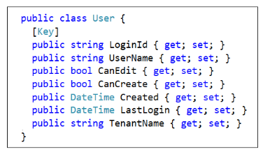
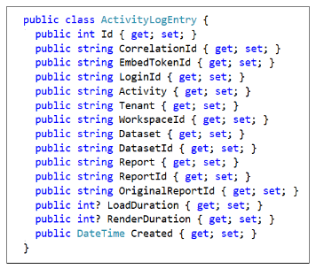
AppOwnsDataDB
Entity Framework Core

Slide 28
Agenda
Solution Architecture
Set up your development environment
Open the App-Owns-Data Starter Kit in Visual Studio
Test the AppOwnsDataAdmin application
Test the AppOwnsDataClient application
Use activity logs to monitor user activity and report performance

Slide 29
Setting up your development environment
Create an Azure AD security group named Power BI Apps
Configure Power BI tenant-level settings for service principal access
Create the Azure AD Application named App-Owns-Data Service App
Create the Azure AD Application named App-Owns-Data Client App

Slide 30
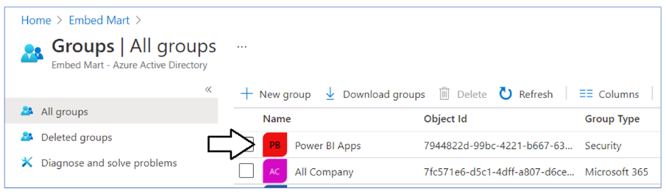
Create the Power BI Apps Group in Azure AD

Slide 31
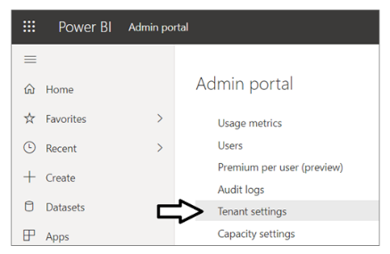
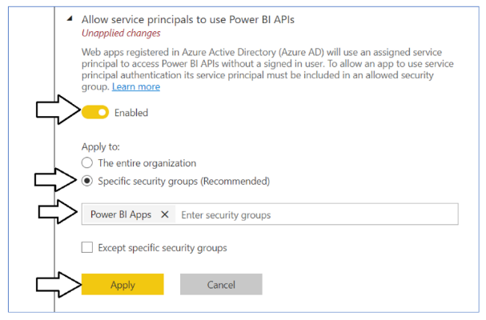
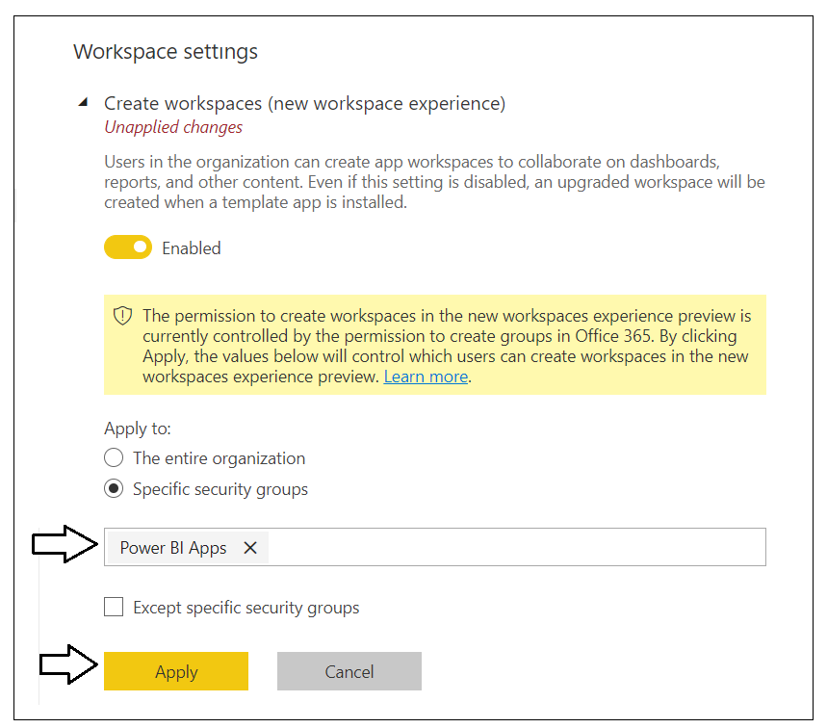
Configure service principal support in Power BI

Slide 32
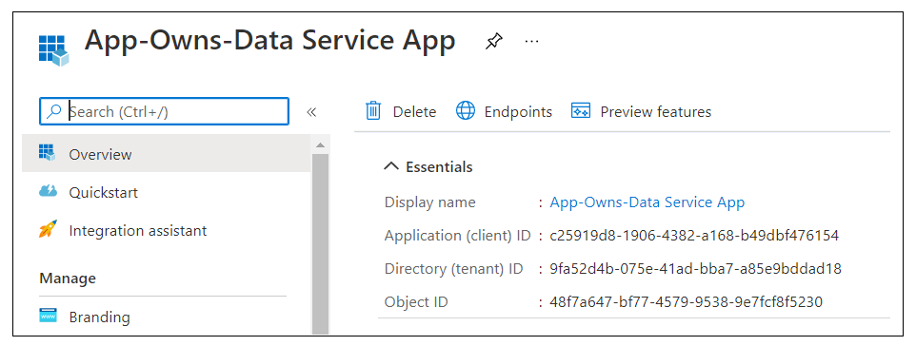
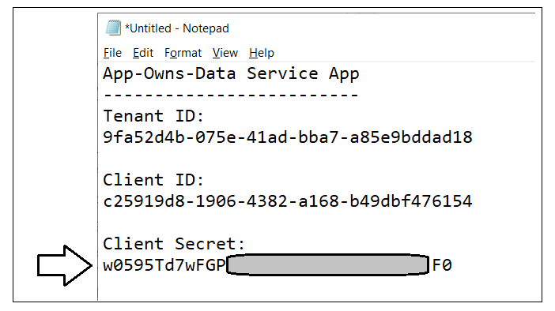
Create the App-Owns-Data Service App

Slide 33
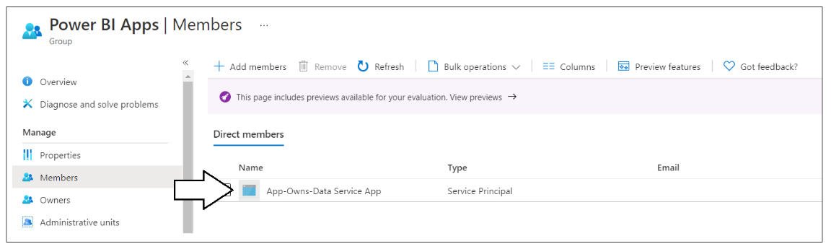
Add the Azure AD App to Power BI Apps Group

Slide 34
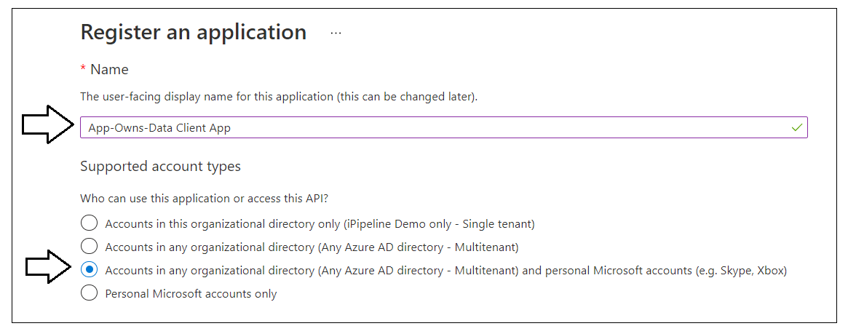
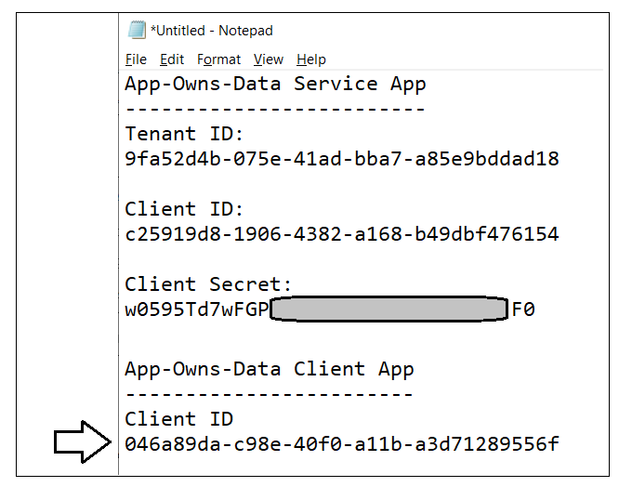
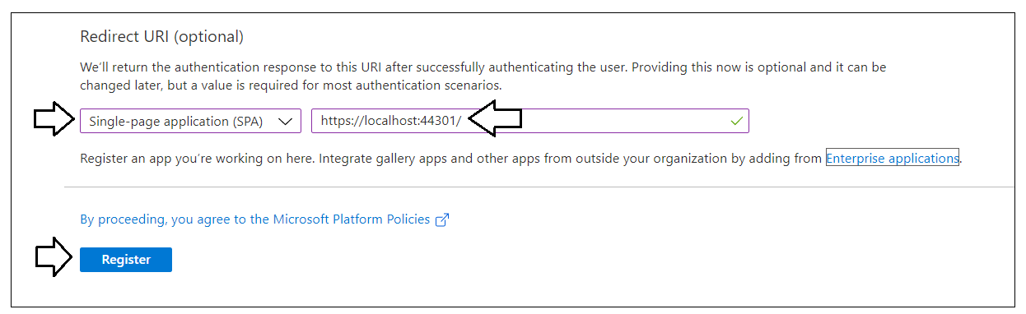
Create the App-Owns-Data Client App

Slide 35
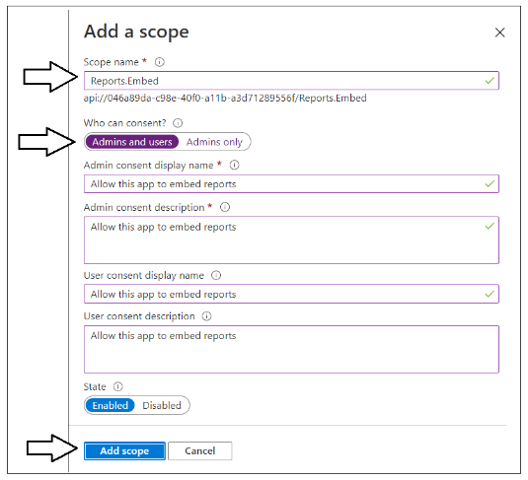
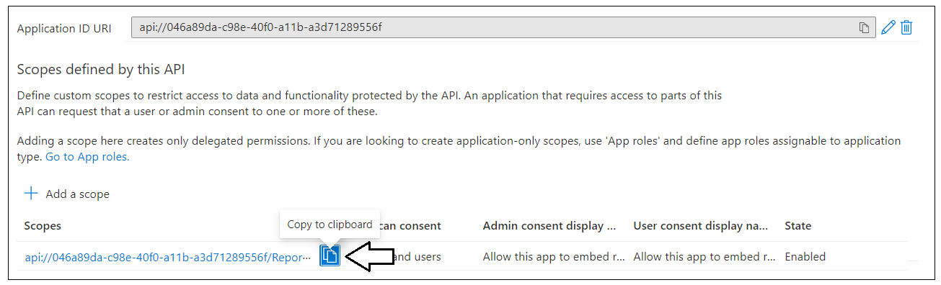
Creating a Custom Scope

Slide 36
Agenda
Solution Architecture
Set up your development environment
Open the App-Owns-Data Starter Kit in Visual Studio
Test the AppOwnsDataAdmin application
Test the AppOwnsDataClient application
Use activity logs to monitor user activity and report performance

Slide 37
Install the Required Developer Software
.NET 5 SDK
https://dotnet.microsoft.com/download/dotnet/5.0
Node.js
https://nodejs.org/en/download/
Visual Studio 2019
https://visualstudio.microsoft.com/downloads/
Visual Studio Code
https://code.visualstudio.com/Download

Slide 38
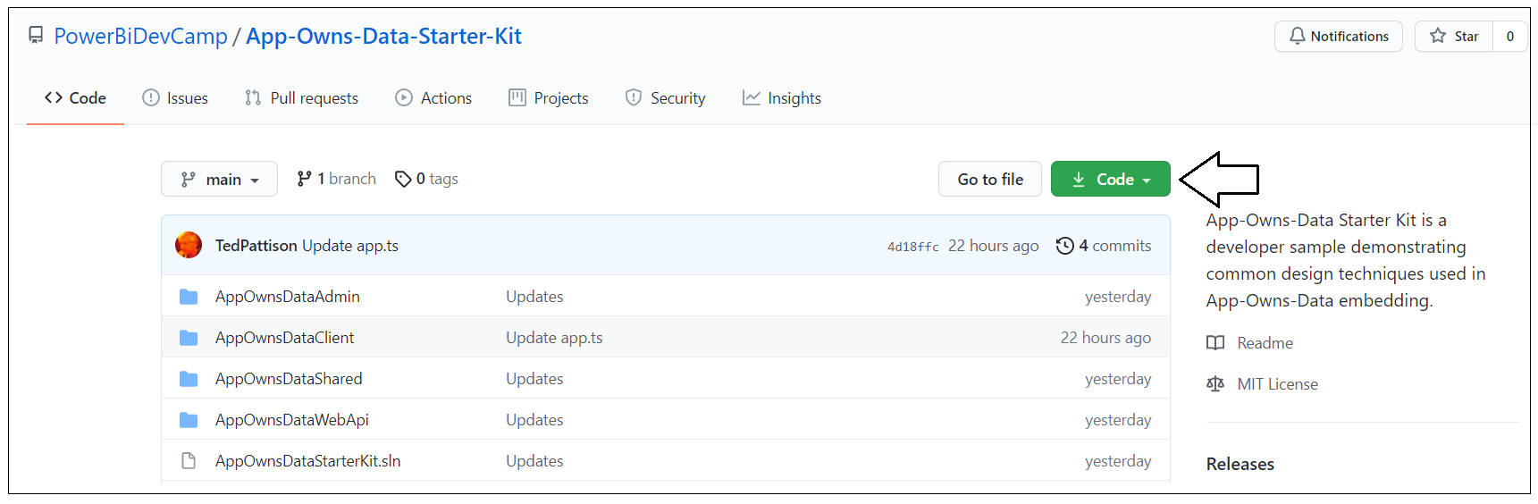
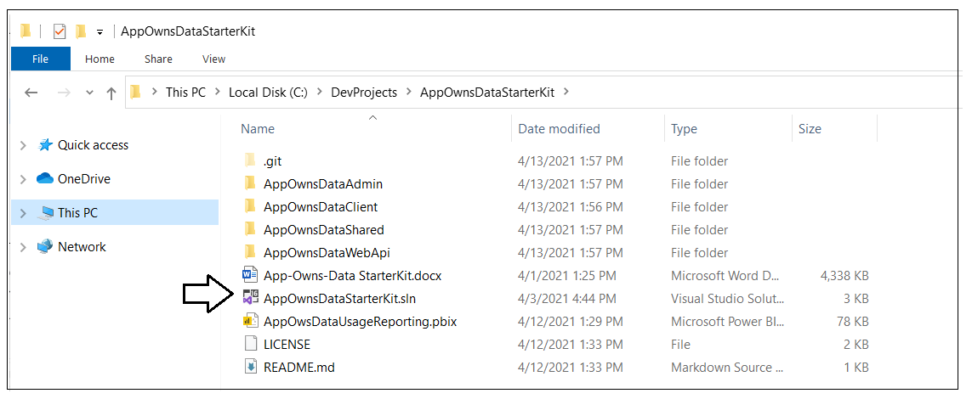
Download the source code

Slide 39
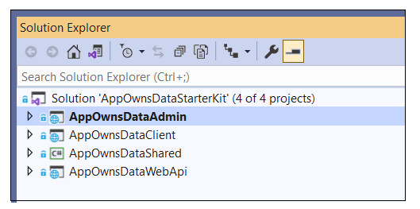
Open AppOwnsDataStarterKit.sln in Visual Studio
AppOwnsDataAdmin: ASP.NET MVC Web Application built using .NET 5
AppOwnsClient: SPA built using HTML, CSS and Typescript
AppOwnsDataShared: Class library project used to generate AppOwnsDataDB
AppOwnsDataWebApi: ASP.NET Web API used by AppOwnsDataClient

Slide 40
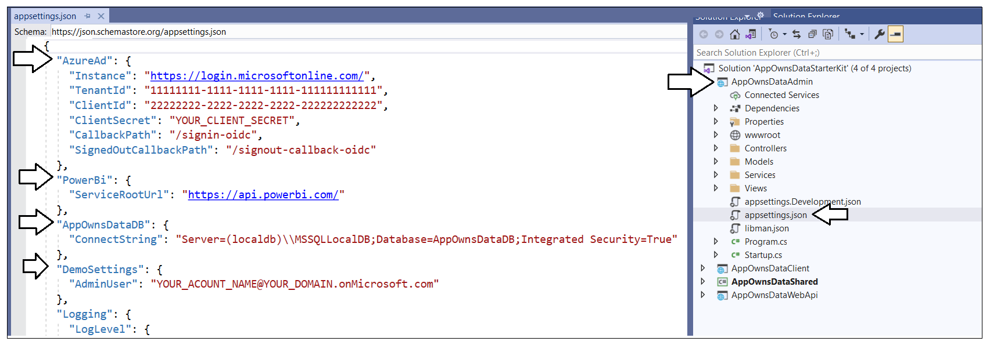
Update appsettings.json in AppOwnsDataAdmin

Slide 41
AppOwnsDataShared class library

Slide 42
AppOwnsDataDB
Entity Framework Core

Slide 43
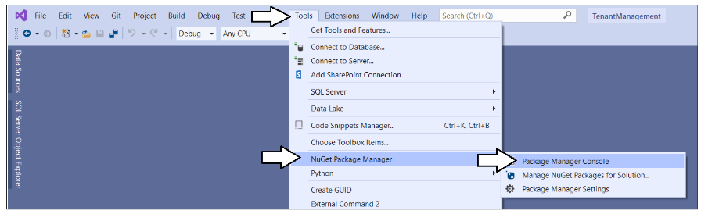
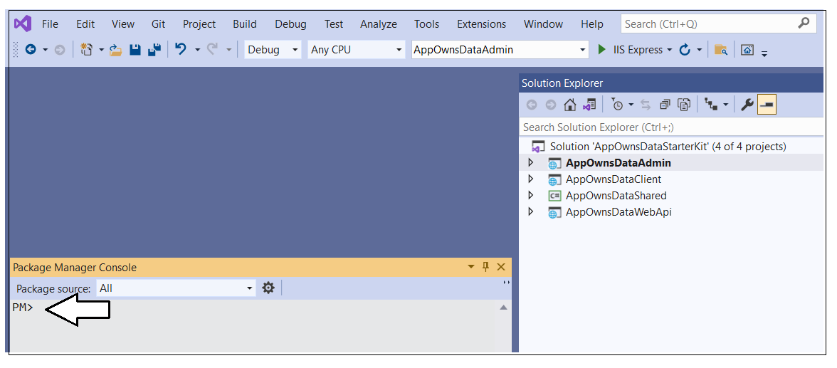
Package Manager Console

Slide 44
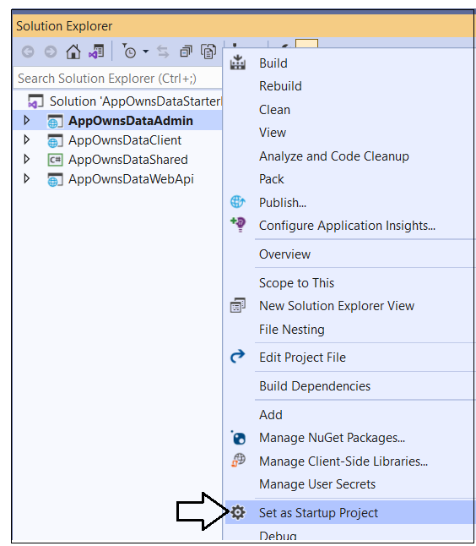
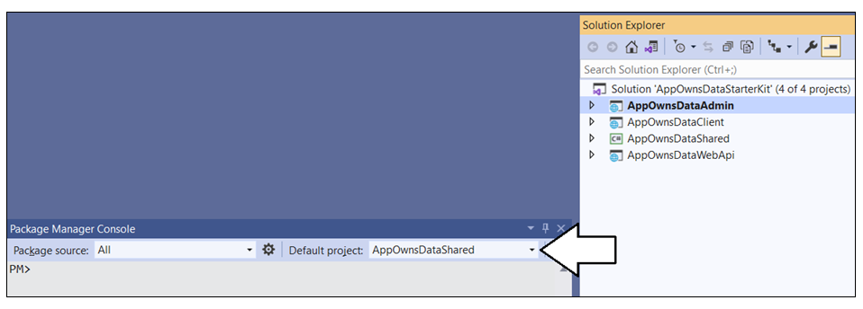
Getting Ready to create the database

Slide 45
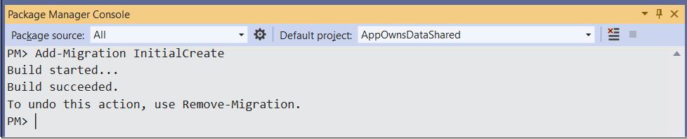
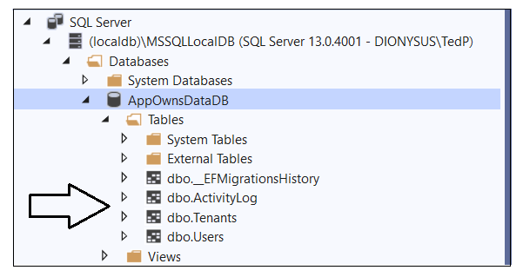
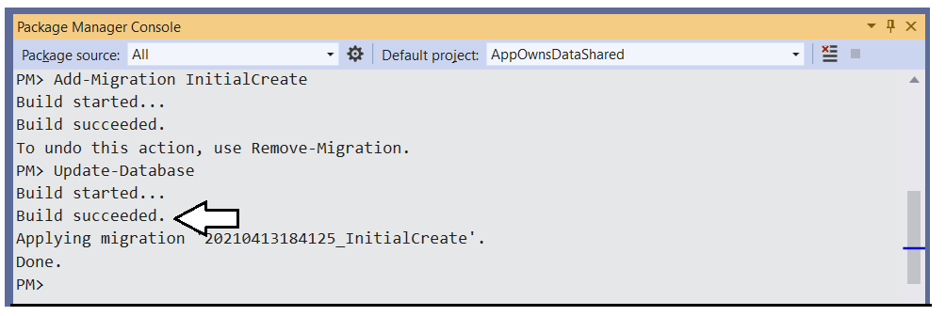
Create the AppOwnsDataDB database

Slide 46
Agenda
Solution Architecture
Set up your development environment
Open the App-Owns-Data Starter Kit in Visual Studio
Test the AppOwnsDataAdmin application
Test the AppOwnsDataClient application
Use activity logs to monitor user activity and report performance

Slide 47
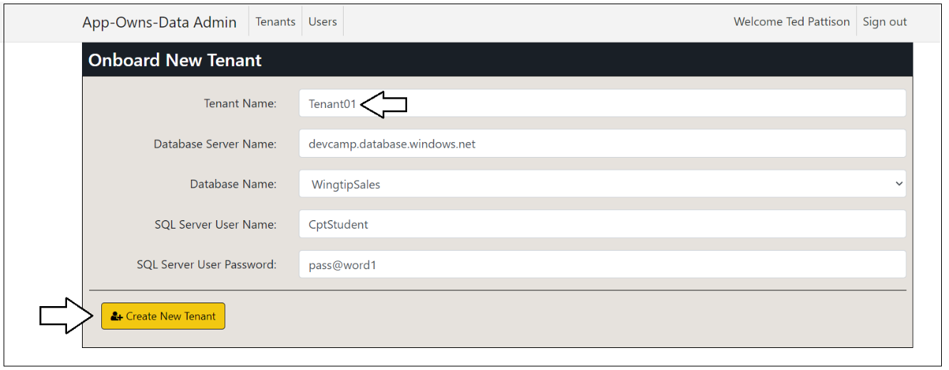
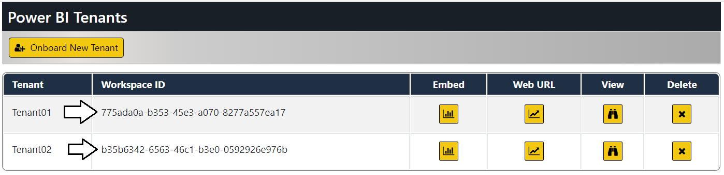
Create New Customer Tenants

Slide 48

Tenant Details

Slide 49



Understanding SalesReportTemplate.pbix

Slide 50



Report Design

Slide 51


Embedding Reports in AppOwnsDataAdmin

Slide 52


What’s been created in Power BI?

Slide 53
Agenda
Solution Architecture
Set up your development environment
Open the App-Owns-Data Starter Kit in Visual Studio
Test the AppOwnsDataAdmin application
Test the AppOwnsDataClient application
Use activity logs to monitor user activity and report performance

Slide 54

Update appsettings.json in AppOwnsDataWebApi

Slide 55

Configure and build AppOwnsDataClient

Slide 56

Node.js integration

Slide 57



Building AppOwnsDataClient

Slide 58


Test AppOwnsDataClient in Visual Studio

Slide 59

Side by Side

Slide 60



Assign User Permissions

Slide 61



User Experience

Slide 62



Edit reports using AppOwnsDataClient

Slide 63



Create new content using AppOwnsDataClient

Slide 64
Agenda
Solution Architecture
Set up your development environment
Open the App-Owns-Data Starter Kit in Visual Studio
Test the AppOwnsDataAdmin application
Test the AppOwnsDataClient application
Use activity logs to monitor user activity and report performance

Slide 65

Monitor user activity data from ActivityLog table

Slide 66

AppOwsDataUsageReporting.pbix

Slide 67

Capturing Report Performance Data

Slide 68
Monitor Report Performance

Slide 69
Next Steps
Use a different authentication provider
Create a more granular permissions scheme
Add integration with row-level security (RLS)
Redesign AppOwnsDataClient using React.js or Angular
Learn scaling techniques to support more than 1000 tenants

Slide 70
Summary
Solution Architecture
Set up your development environment
Open the App-Owns-Data Starter Kit in Visual Studio
Test the AppOwnsDataAdmin application
Test the AppOwnsDataClient application
Use activity logs to monitor user activity and report performance

